Slide 1

Home Field Advantage

Slide 2
Project Overview
The purpose of this project was to determine whether home field advantage played a role in a team's success. This is what teams fight for when moving on to the playoffs because it is believed that they stand a better chance at moving forward if they have more home games or certain home games during a series.

Slide 3
Data
To determine this we used data from 3 major sports
NBA - nba_api.stats
NFL - Kaggle
MLB - Kaggle

Slide 4
Process
Retrieve date
From api and kaggle
Clean data
Using python notebooks with pandas
Set data to matching format
Sent to MongoDB
Create app
Html/CSS/JS
Flask
Bootstrap
D3
Leaflet

Slide 5
App setup
INDEX.HTML
Home page
BAR.HTML
Holds bar container
TRAVEL-MAP.HTML
Holds map container
DATAPAGE.HTML
Holds table container
LAYOUT.HTML
Holds bootstrap
Navbar
JS calls
APP.PY
Contains flask app with routes to all pages
.JS FILES
bar-page
Pulls data for bar chart
Datapage
Pulls data for search tables
Travel-map
Pulls data and logos for map
Leaflet.geodesic
Sets circles and lines based on lat/longs
MAIN.CSS
Set style for a lot of the text/visualizations

Slide 6
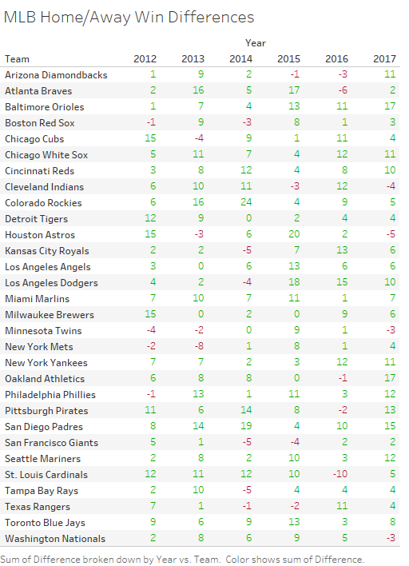
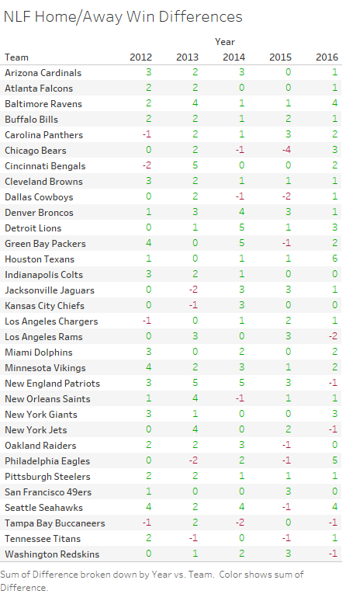
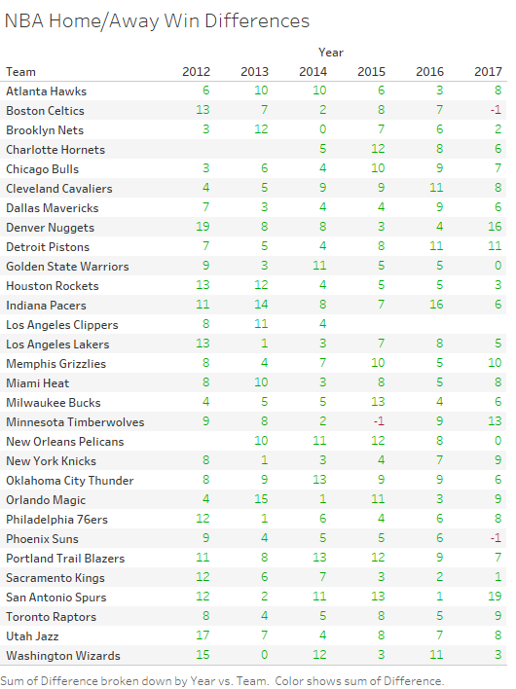
Findings

